Slide 1
By: Mrs. Gebarowski

Slide 2
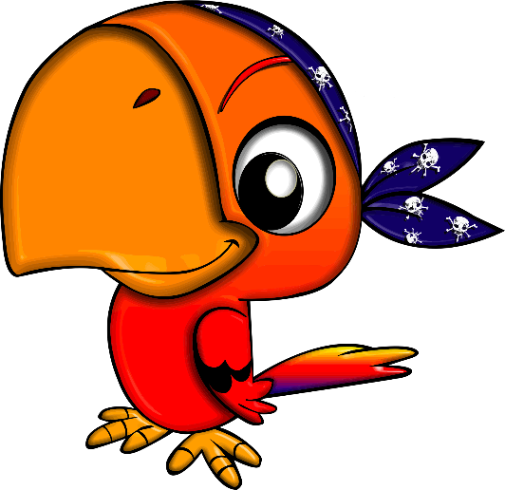
They have pet parrots. They say arrrrrr
AAArrrrrrrrrrrrrr!

Slide 3
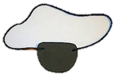
They have cool hats. They wear eye patches

Slide 4
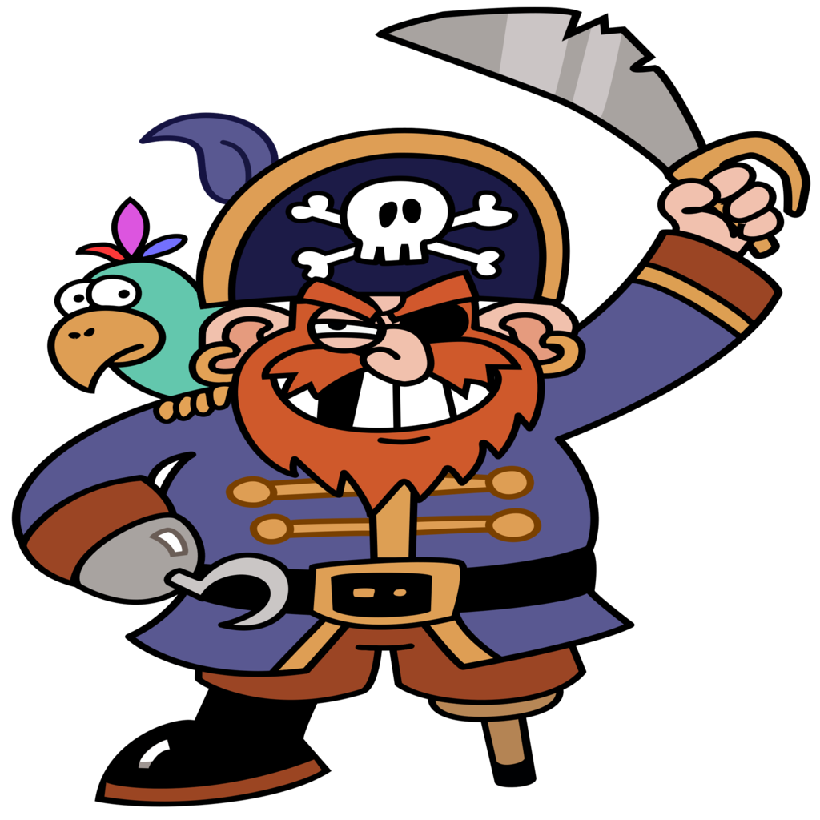
Do you like pirates?

