Slide 1
Recycling
By:

Slide 2
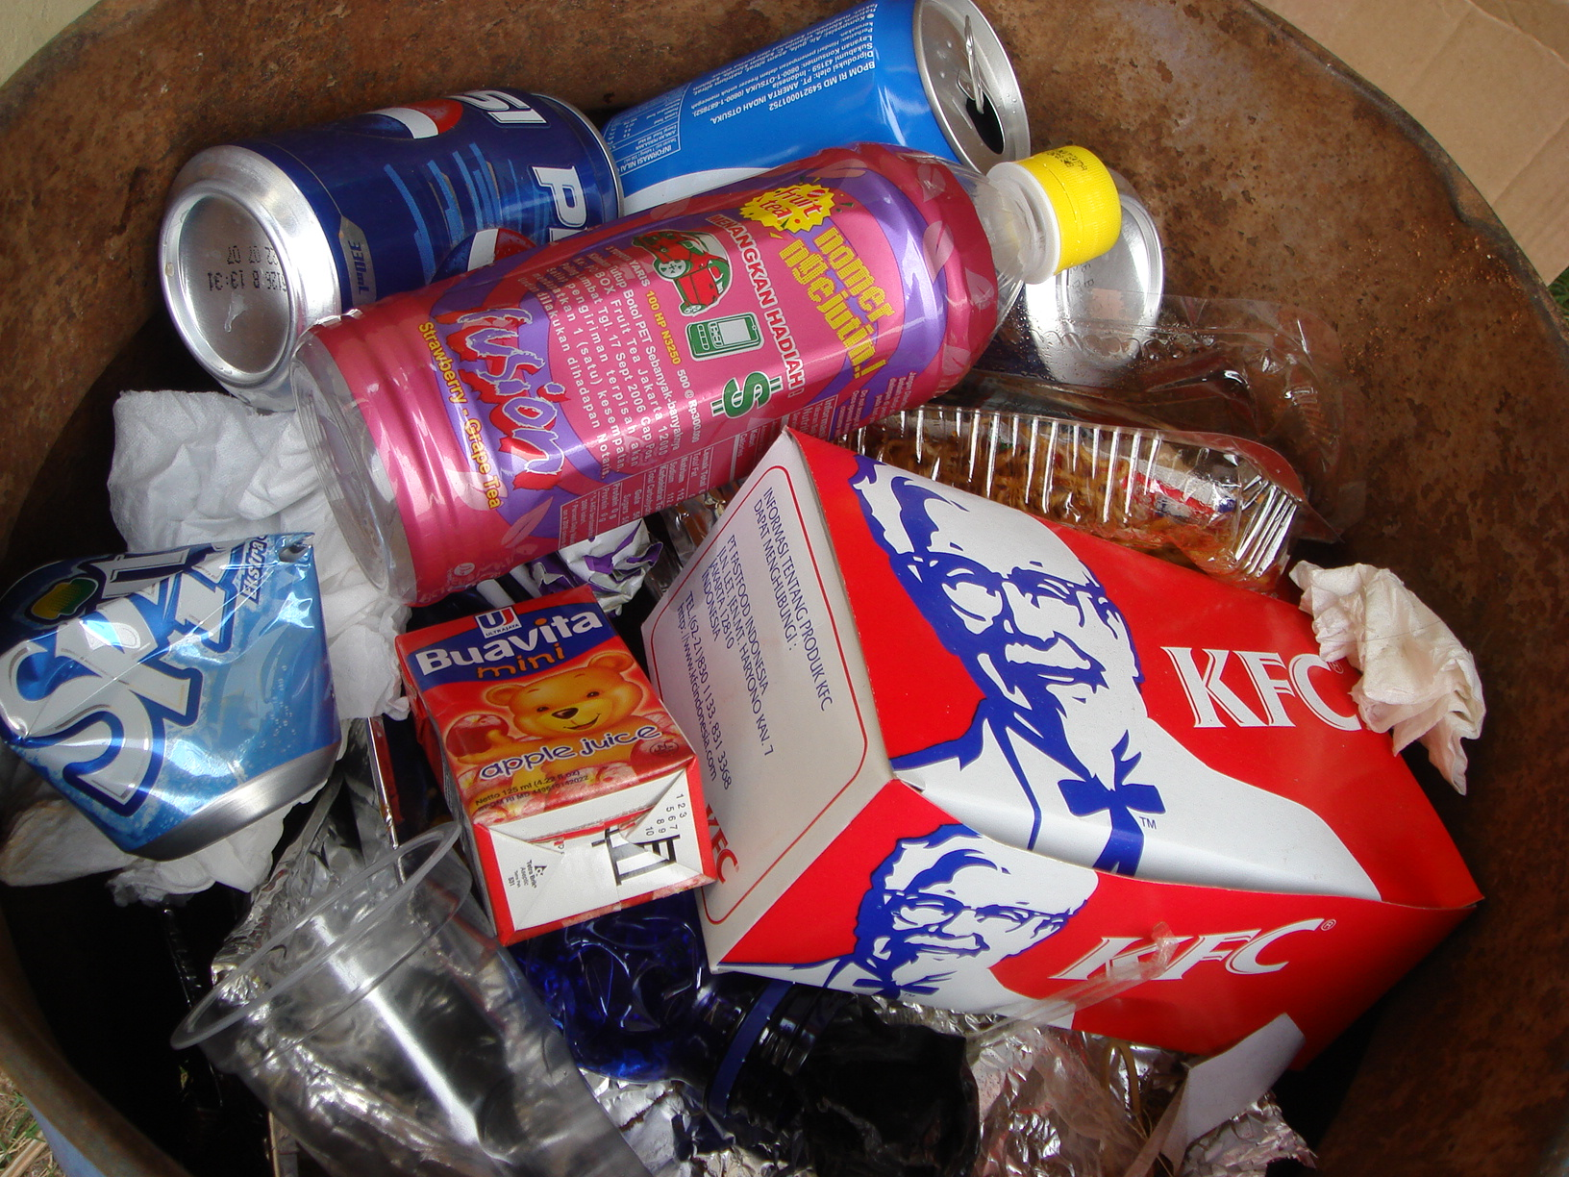
You will help organize information using an outline and Smart Art.
Go to slide 3 and lets list some paper, plastic, and can items that can be recycled

Slide 3
Recycle, Recycle, Recycle
Paper
Plastic
Cans

Slide 4
Recycle, Recycle, Recycle
Paper
newspapers
Cans
Pop
Plastic
Bags

