Slide 1

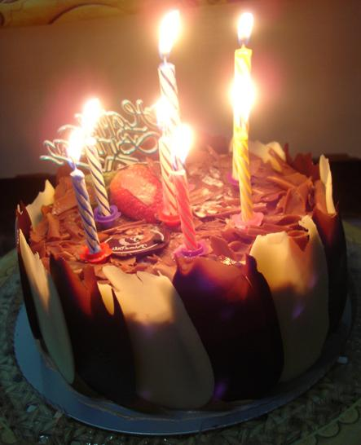
The Birthday Party
By
Jill Gillen
Notes:
Key Objectives:
Students will be able to predict which item will be purchased next by identifying the object on the left of each frame.

Slide 2
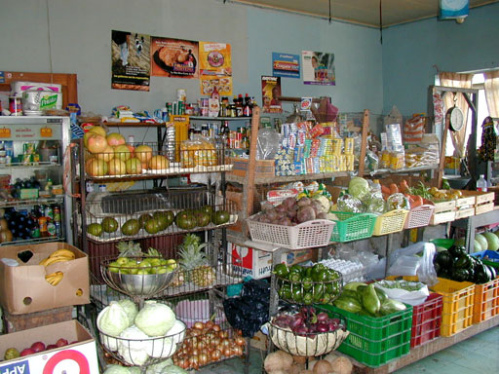
Leo went to the store with his Mother. They were getting supplies for his birthday party.

Slide 3
List
cake mix
frosting
ice cream
candles
punch
Leo and Mother read their shopping list to remember what to buy. They needed cake mix, frosting, ice cream, candles, and punch for the party.

Slide 4

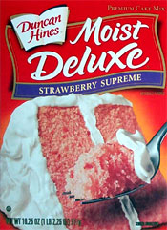
“Mother, we need a cake mix. Where can I find the chocolate cake?” asked Leo.
“The chocolate cake is to the left of the strawberry cake. Would you put it in the basket, please?” replied Mother.

Slide 5
List
cake mix
frosting
ice cream
candles
punch
Leo checked the list. Now he and his Mother only needed to get four more items for his party; frosting, ice cream, candles, and punch.

Slide 6
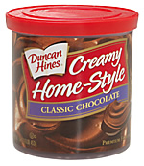
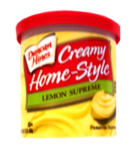
“Mother, we need frosting for the birthday cake. Where can I find the chocolate frosting?” asked Leo.
“The chocolate frosting is to the left of the lemon frosting. Would you put it in the basket, please?” replied Mother.

Slide 7
List
cake mix
frosting
ice cream
candles
punch
Leo checked the list. Now he and his Mother only needed to get three more items for his party; ice cream, candles, and punch.

Slide 8
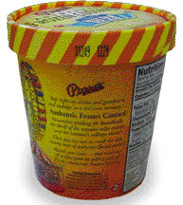
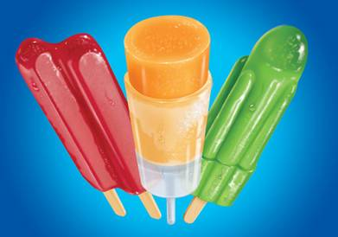
“Mother, I want to have chocolate chip cookie dough ice cream with my birthday cake,” said Leo.
“Great! The ice cream is to the left of the popsicles. Put it in the basket with the other items,” said mother.

Slide 9
List
cake mix
frosting
ice cream
candles
punch
Leo checked the list again. Now he and Mother only needed to get two more items for his party; candles, and punch.

Slide 10

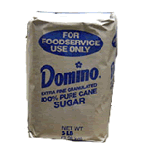
“How many candles will you need on your birthday cake?” asked mother.
“I am going to be six years old. I will need six candles on my cake,” said Leo.
“Please put a box of candles in the basket, Leo. They are to the left of the sugar,” said Mother.

Slide 11
List
cake mix
frosting
ice cream
candles
punch
Leo checked the list another time. Now he and Mother only needed to get one more item for his party; punch.

Slide 12
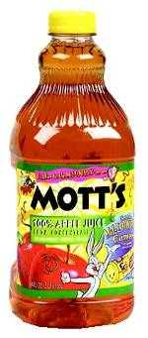
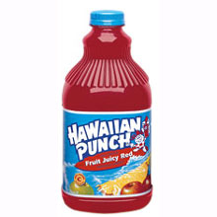
“Do you remember where we can find the punch, Leo?” asked Mother.
“Yes, it is to the left of the apple juice. I’ll put it in the basket.” said Leo.

Slide 13
List
cake mix
frosting
ice cream
candles
punch
Finally the list was complete. Now Leo and Mother could go home and get ready for the party.

Slide 14
Happy
Birthday,
Leo!

Slide 15
Bibliography of pictures used from the web on the Power Point Talking Book.
Hometown Favorites, Inc., (n.d.). Hometown favorites. Retrieved Jun. 14, 2005, from Ole-Time Favorites and Regionally Exclusive
Foods Web site: http://www.hometownfavorites.com/images/items/Large/hfde405.jpg.
(n.d.). Retrieved Jun. 14, 2005, from Image Hosting and Online Albums Web site: http://img.photobucket.com/albums/v434/yunnie75/bdae_cake.jpg.
(
2005). Retrieved Jun. 15, 2005, from The Global Gourmet Web site: http://www.globalgourmet.com/food/ild/2002/0602/cake.jpg.
(2004). Retrieved 06 14, 2005, from Solo Regalos Web site: http://www.solo-regalos.com.es/catalog/images/chocolate%20frosting.jpg.
(2004). Retrieved Jun. 15, 2005, from Solos Regalos Web site: http://www.solo-regalos.com.es/catalog/images/classic%20strawberry%20frosting.jpg.
(2004). Retrieved Jun. 14, 2005, from Hometown Favorites Web site: http://www.hometownfavorites.com/images/items/Large/hfde464.jpg.
"Today's Packaging News." Packaging Digest. 2004. Packaging Digest. 14 Jun. 2005 <http://www.packagingdigest.com/articles/200204/Images/0402pierre2.jpg>.
(2005). Retrieved Jun. 14, 2005, from AZ Trading Post Web site: http://www.southwestinterior.com/sonoran/images/IN-2594-1.jpg.
(2005). Retrieved Jun. 14, 2005, from FoodServiceDirect.com Web site: http://www.foodservicedirect.com/productimages/hawailans.jpg.
(2005). Retrieved Jun. 14, 2005, from Rite Aid Web site: http://www.riteaid.com/product_images/full/T68/T68376.jpg.
(2002). Retrieved Jun. 14, 2005, from Coffee For Less.com Web site: http://www.coffeeforless.com/images/uploads/Domino_5lb_sugarF.gif.
(n.d.). Retrieved Jun. 14, 2005, from Dellorco Design Web site: http://www.dellorcoart.com/portfolio/food/images/3%20popsicles.jpg.

